Slide 1
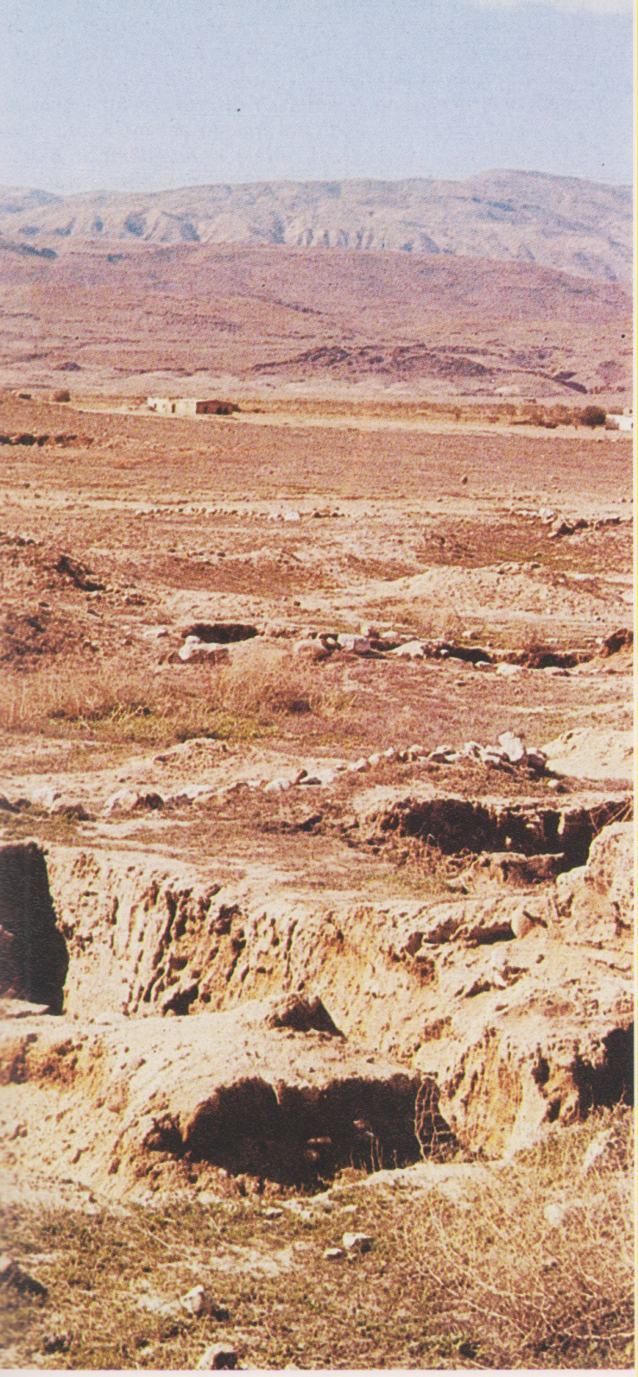
Moab, i monti con la stesppa

Slide 2
A theoretical map of the region around 830 BCE. Moab is shown in purple on this map, between the Arnon and Zered rivers.

Slide 3
Moabite sarcophagus in Jordan Archaeological Museum in Amman

Slide 4
The Mesha stele as photographed circa 1891. The stele describes King Mesha's wars against the Israelites.

