Slide 1
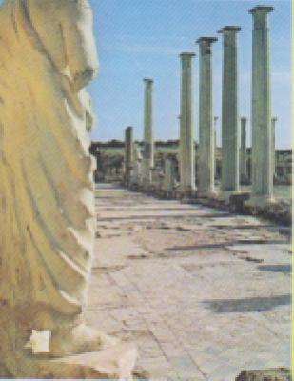
Cipro, Salamina, rovine romane

Slide 2
